Slide 1
The Fours Seasons of COVID-19 in 2020
By: Sarah Anleu, Ramazan Khaev, Ryan Kracaw, Opeyemi Sodipe

Slide 2
What is the relationship between weather and COVID-19 cases during the four seasons in 2020?
The data:
First data set displayed date, county, cases, and deaths
Second data set displayed a city within each county
Limitations:
OpenWeather charges API requests for historical data
COVID-19 data is from Kaggle, which may or may not be accurate
The process:
Parsed data into our respective seasons
Picked 3 counties (Harris, Maricopa, and King)
Gathered weather data for each day with the OpenWeather API
Ran a linear regression
Created scatter plots

Slide 3
Questions
What is the relationship between temperature (C) and daily COVID-19 cases in each of our 3 counties in 2020?
What is the relationship between temperature (C) in and daily COVID-19 deaths in each of our 3 counties in 2020?
What is the relationship between humidity (%) in and daily COVID-19 cases in each of our 3 counties in 2020?
What is the relationship between wind speed (m/s) in and daily COVID-19 cases in each of our 3 counties in 2020?

Slide 4
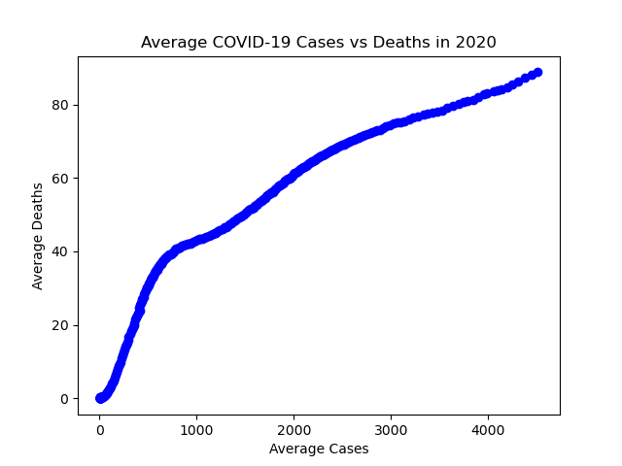
Spring
Average Cases vs Deaths in 2020
As you can see the Data is going in a positive linear line and we can safely assume since it was the beginning of COVID-19 that the data will be affected by it by the increasing number of cases and deaths.

Slide 5
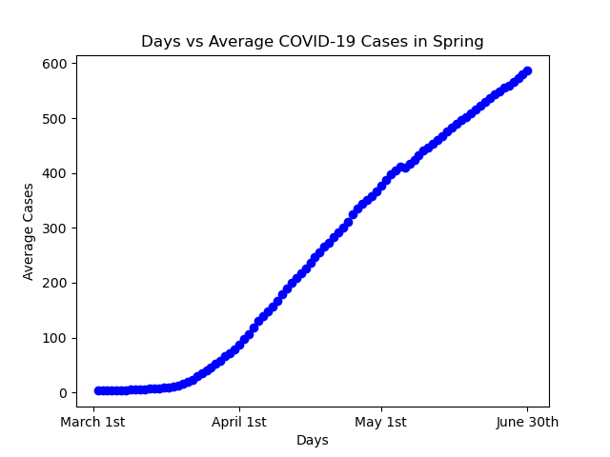
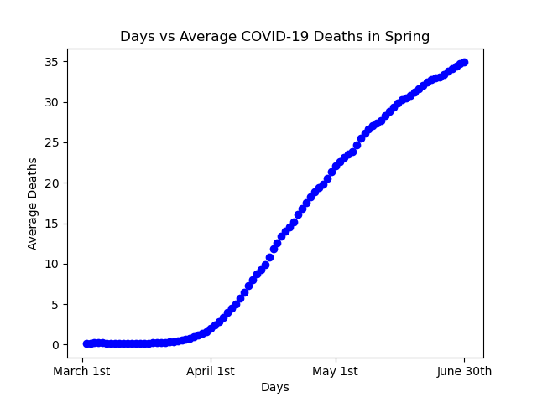
Spring
Days vs Average Cases
Days vs Average Deaths
Both plots show a positive linear regression

Slide 6
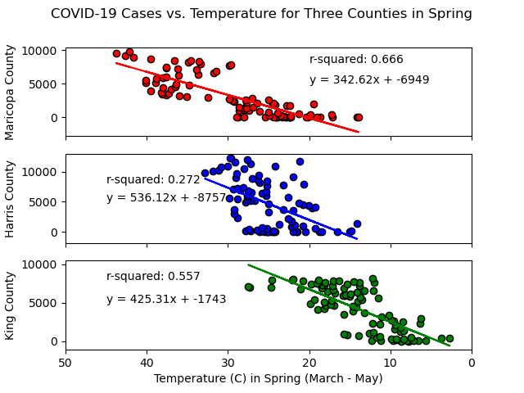
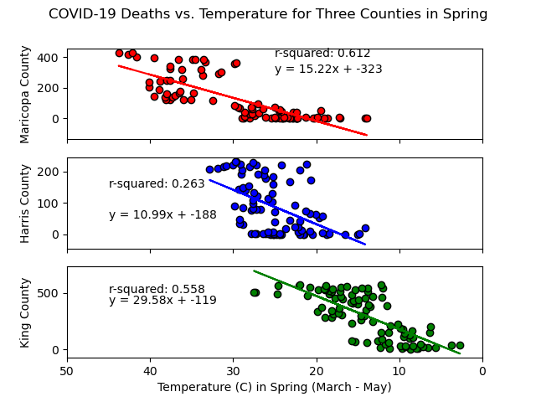
Spring
Cases vs Temperature
Deaths vs Temperature
The plots demonstrate from r squared that there could be a possible correlation but we cannot be sure just from this data
********* Harris County Issues*********

Slide 7
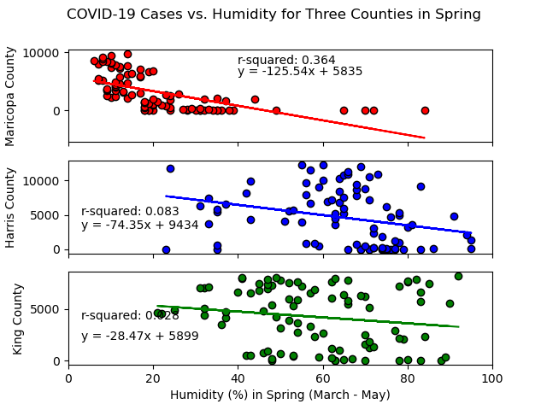
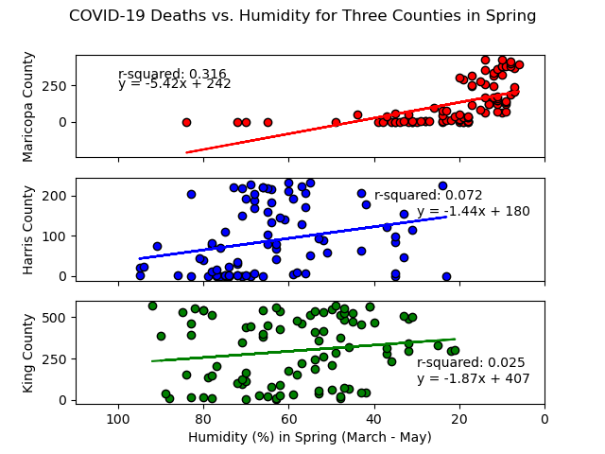
Spring
Cases vs Humidity
Deaths vs Humidity
From seeing the plots we can see that they differ in many ways including that comparing both plots have opposite regressions

Slide 8
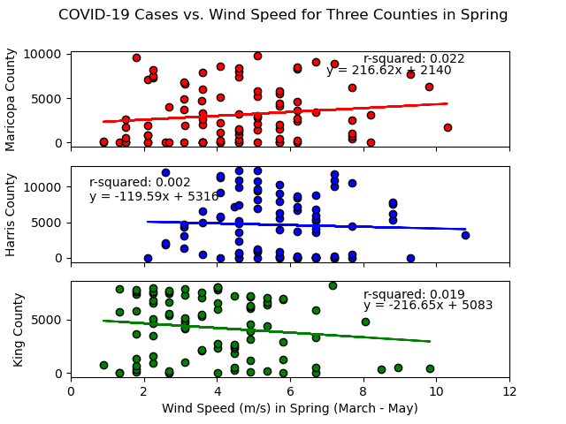
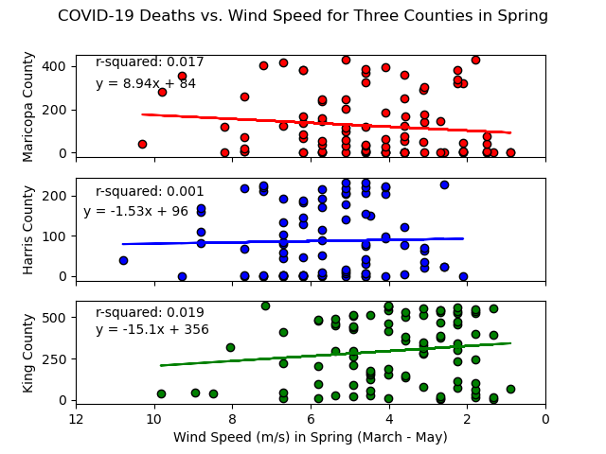
Spring
Cases vs Wind Speed
Deaths vs Wind Speed
Out of all the data plots this one shows no correlation that they could have a relation which is why we can it from the r-square’s as well as the staggered points

Slide 9
Spring Conclusion
Due to my season being around the start of the year we are able to see a clear increase in data over time which can affect how data is visualized especially in my numbers. There wasn’t any strong correlations that can be made from my plots with the exception of the first three I displayed which was the all year of 2020 for Average Cases and Deaths.

Slide 10
SUMMER COVID-19 CASES
YEAR IN VIEW - 2020

Slide 11
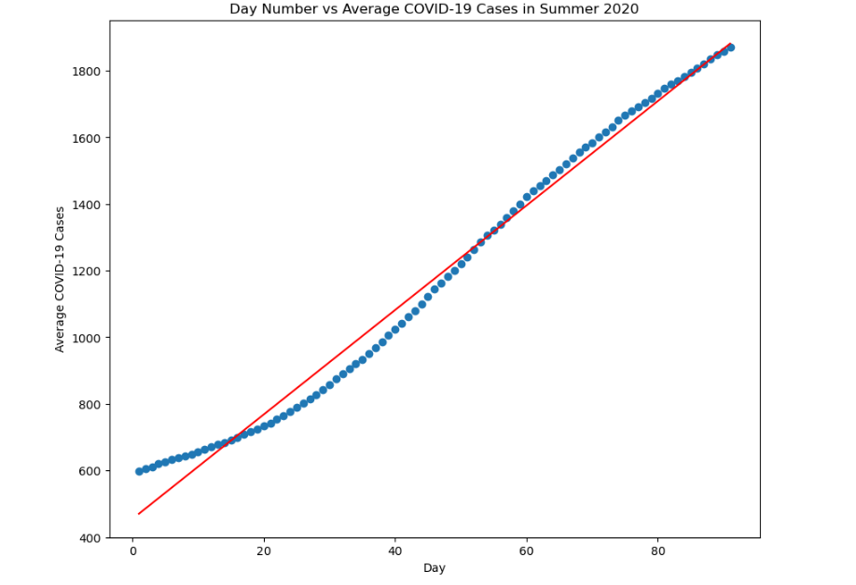
Overview of Summer Covid-19 cases - 2020
In terms of the distribution of cases, we found that the data was right-skewed, with a majority of the counties having a relatively low-average number of cases, while a few counties had a very high number of cases.

Slide 12
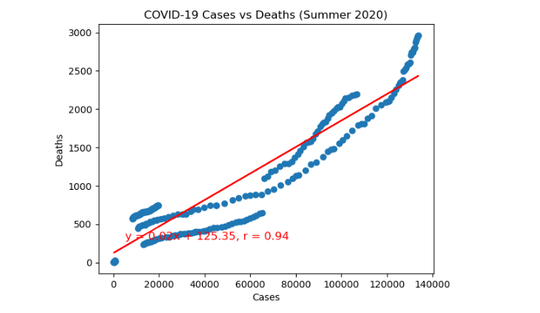
Summer Covid-19
It is evident from this plot output that as the Covid-19 cases increase, death cases was also on the rise.

Slide 13
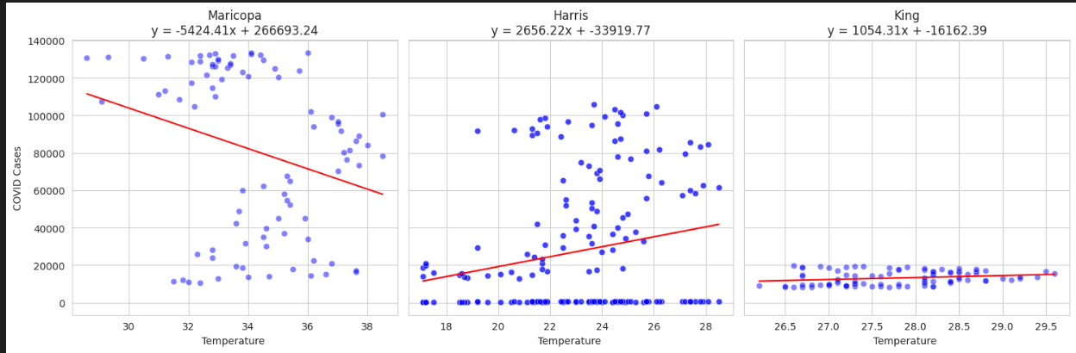
What is the relationship between temperature (C) in summer and daily COVID cases in each of our 3 counties in 2020?

Slide 14
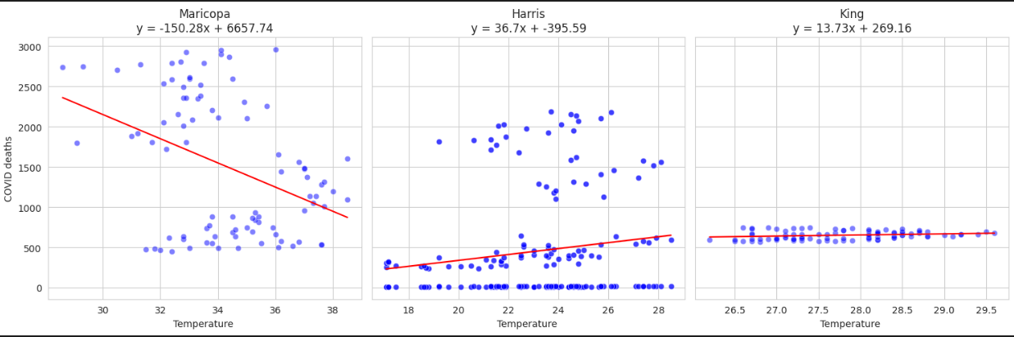
What is the relationship between temperature (C) in summer and daily COVID deaths in each of our 3 counties in 2020?

Slide 15
Temperature Analysis
Maricopa's graph shows a negative gradient, indicating a negative relation between the rise in temperature and the number of cases/deaths. This means that as the temperature increased, the number of cases/deaths decreased. On the other hand, King's graph shows a relatively flat line, suggesting fewer cases/deaths despite an increase in temperature. Harris, however, exhibited a positive relation, indicating that the number of deaths increased as the temperature rose. The same pattern was observed for the number of cases in relation to temperature for each county.
As evident in Maricopa county, when the temperature is beyond 30, there’s high correlation, while the correlation is lower when the temperature is below 30.
In Conclusion , temperature might not be a 100% predictor of Covid-19 Cases/Deaths since the relationship between Covid-19 cases vs temperature differ across the analyzed counties.

Slide 16
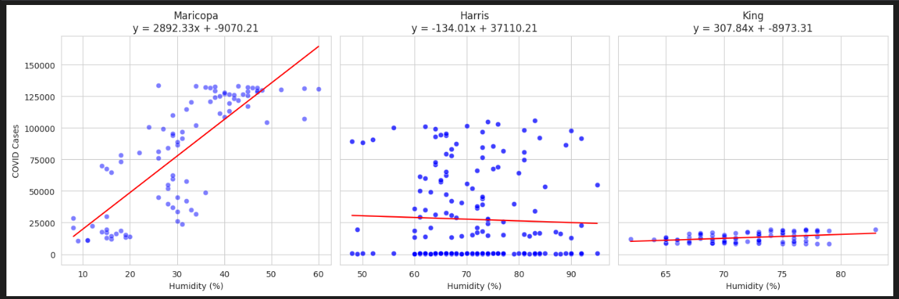
What is the relationship between humidity (%) in summer and daily COVID cases in each of our 3 counties in 2020?

Slide 17
Humidity -Analysis
When examining the relation between humidity and the number of cases, Maricopa displayed a steep positive gradient, suggesting that humidity was a highly contributing factor to the increase in COVID cases. In Harris and King, the line was relatively flat, indicating that humidity had less impact as a contributing factor. In fact, in Harris, the number of COVID cases even slightly decreased.
Conclusively, humidity does not have a direct influence on Covid-19 Cases trend. It does matter but in specific ranges. When the conditions are extremely dry, the cases are lower.

Slide 18
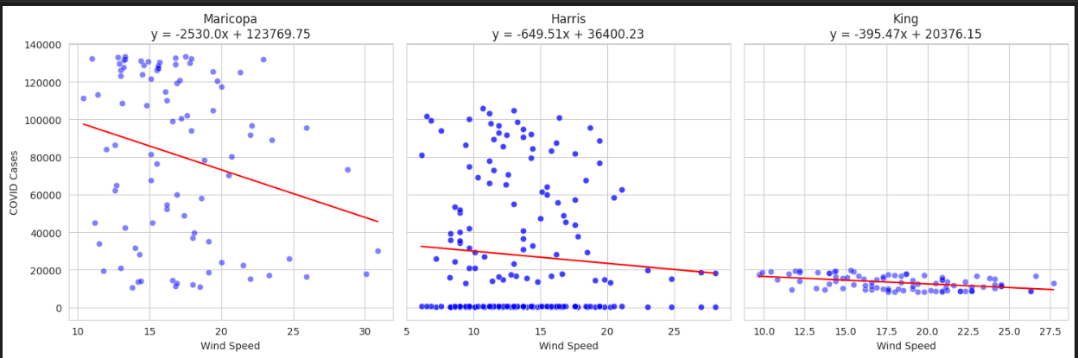
What is the relationship between Wind Speed in summer and daily COVID cases in each of our 3 counties in 2020?

Slide 19
Wind Speed -Analysis
Looking at the wind speed, all three counties showed a negative gradient, especially Maricopa. Harris and King also had a negative gradient, although not as significant.
This provides conclusive insight that wind speed was not a contributing factor to the number of COVID-19 cases.

Slide 20
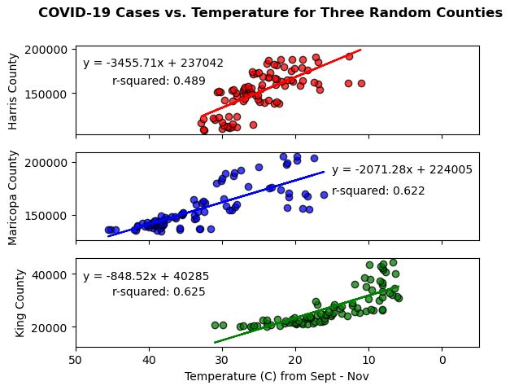
What is the relationship between temperature (C) in fall and daily COVID cases in each of our 3 counties in 2020?
Analysis:
Inverse relationship between temperature and COVID-19 cases
The r-squared values suggest a moderate to strong correlation
The r-squared values indicate that half to two-thirds of the variance in COVID-19 cases can be explained by temperature
Correlation does not imply causation!

Slide 21
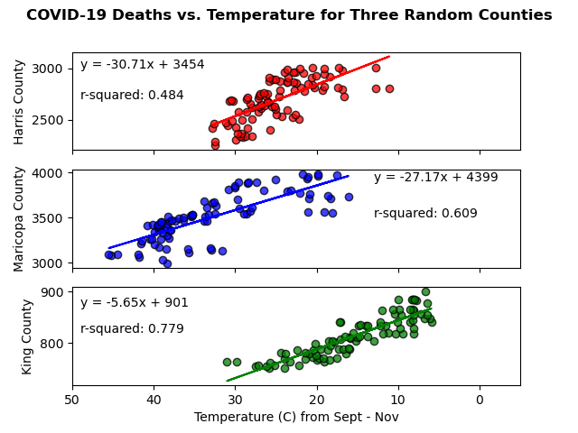
What is the relationship between temperature (C) in fall and daily COVID deaths in each of our 3 counties in 2020?
Analysis:
Very similar to cases vs temperature
Can’t have a COVID-19 death without a COVID-19 case
There is some correlation between COVID-19 deaths and temperature
Perdiction: How many COVID deaths will there be if the temperature reached -5 C in King County?
925 deaths

Slide 22
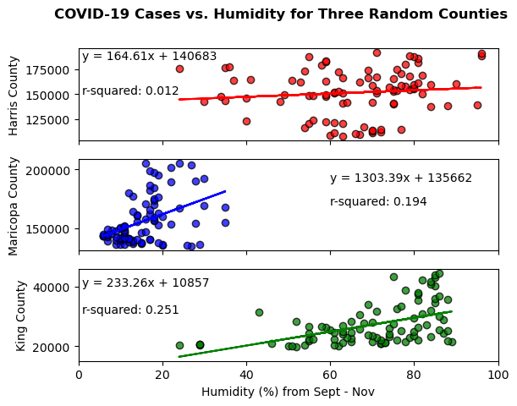
What is the relationship between humidity (%) in fall and daily COVID cases in each of our 3 counties in 2020?
Analysis:
Lots of scattered data
Very weak to no correlation according to the r-squared values
No relationship between humidity and COVID-19 cases

Slide 23
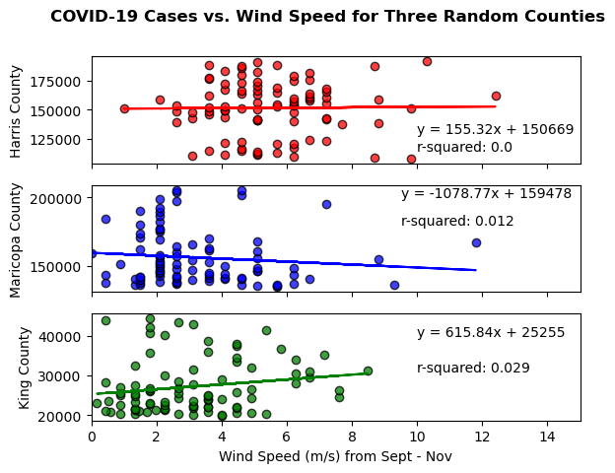
What is the relationship between wind speed in fall and daily COVID cases in each of our 3 counties in 2020?
Analysis:
Very weak to no correlation according to r-squared value
No relationship between wind speed and COVID-19 cases

Slide 24
Conclusion
Correlation does not mean causation
Need more analysis for other contributing factors
Wind speed has no correlation with COVID-19 (the virus doesn’t travel more on a windy day)
Humidity has a moderate correlation but some counties can be cold and humid (Seattle WA) and some can be hot and humid (Houston TX)

